Slide 1
Prudential Retirement Mobile App
Retirement planning at participants’ fingertips

Slide 2
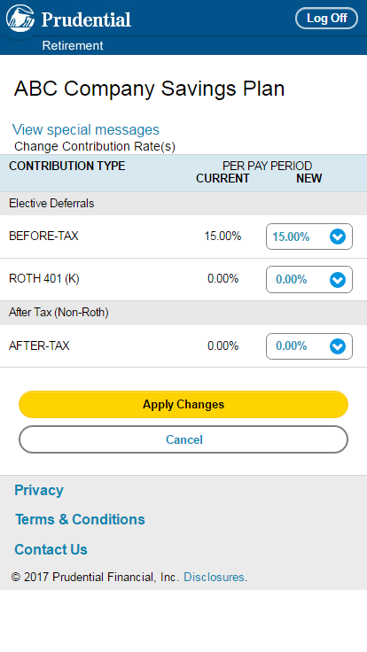
From web-based to native application with the most-requested transactional features
Listening to customers
Retirement clients and participants told us they wanted a new and better app in order to access their plans on the go, anywhere and anytime.
In December 2018, the initial build was released with the primary objective of transitioning functionality to a modernized, scalable mobile experience with the ability to be continually enhanced with new features, functions and content.
December 2018
In January 2020, additional transactional features were added closing gaps with competitors.
January 2020
For videos and animations of the app experience visit: www.prudential.com/app
www.onelink.to/prudential

Slide 3
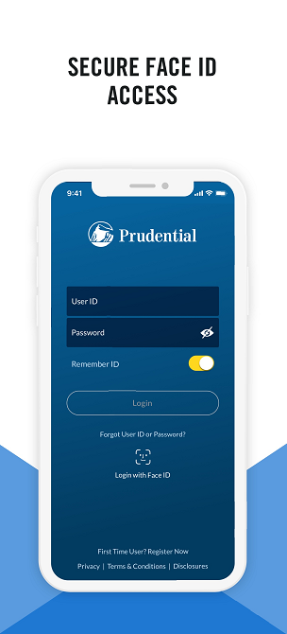
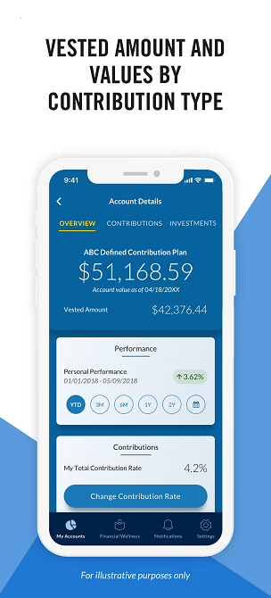
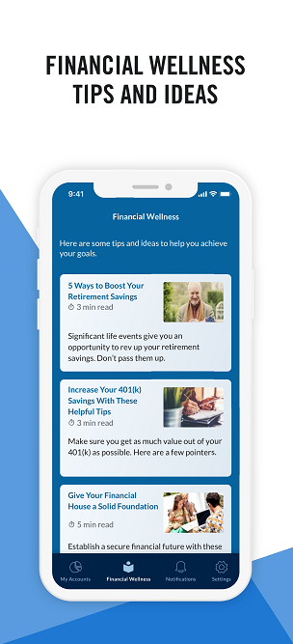
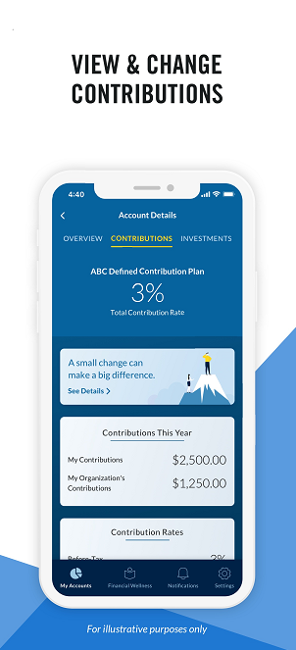
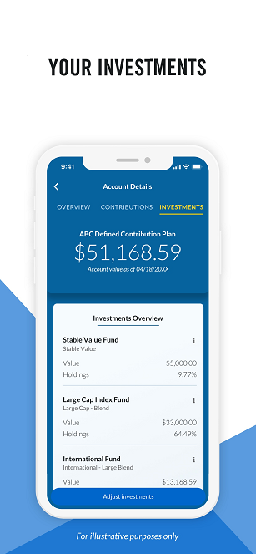
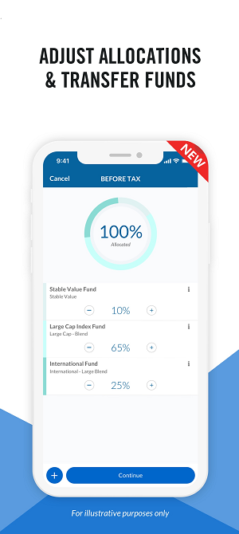
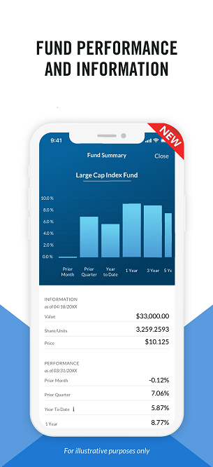
Enhanced customer experience focused on ease, convenience and personalization
“The Prudential Retirement app represents a great example of the journey Prudential is on to meet our individual customers where they are, provide the capabilities they expect and eventually connect them with more solutions that will fit their needs,” says Christine Lange, head of Business Management and Customer Solutions for Retirement’s Full Service Solutions unit.

Slide 4
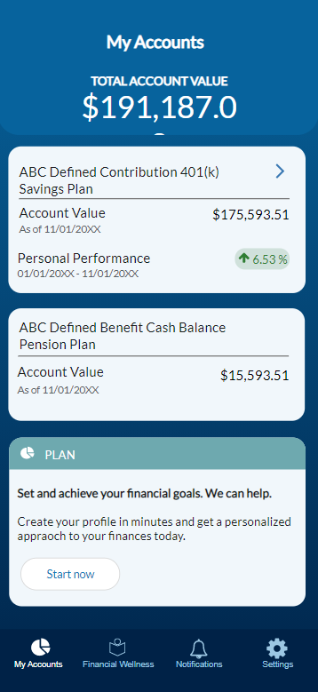
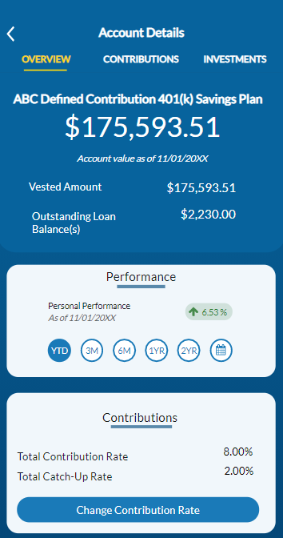
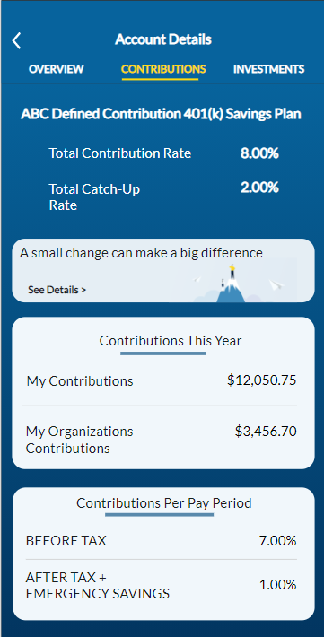
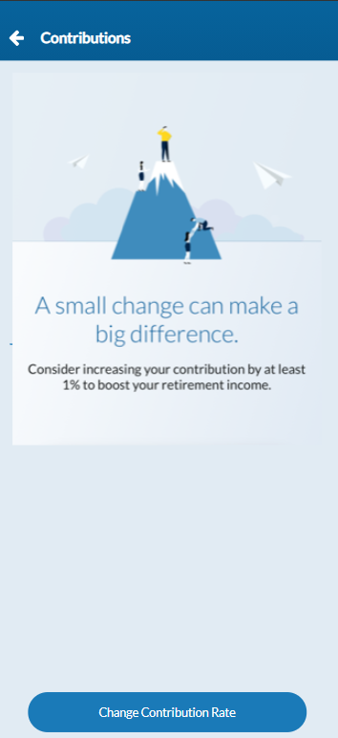
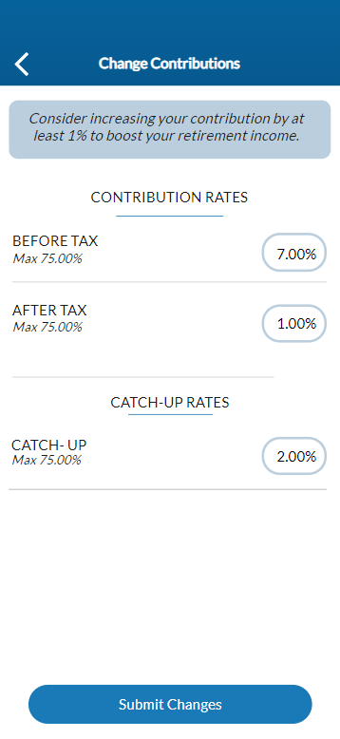
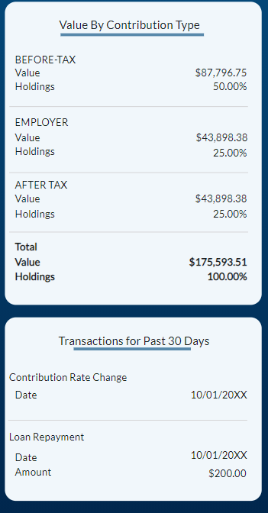
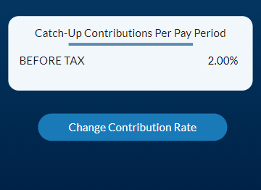
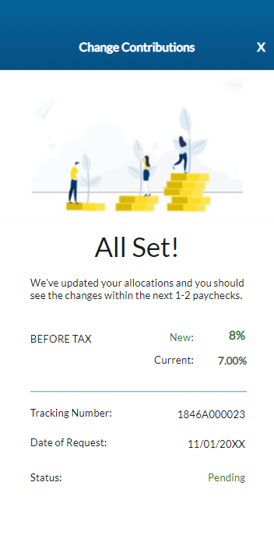

Slide 5
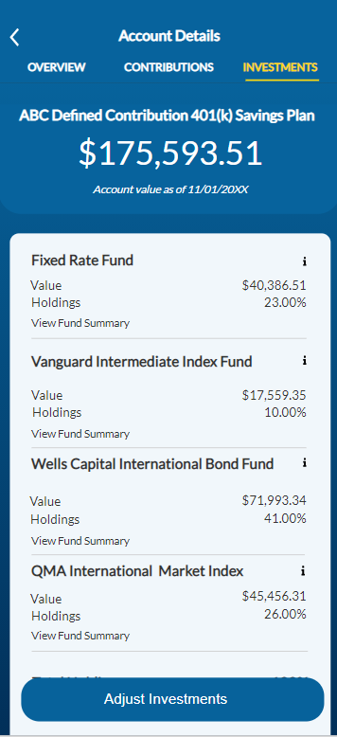
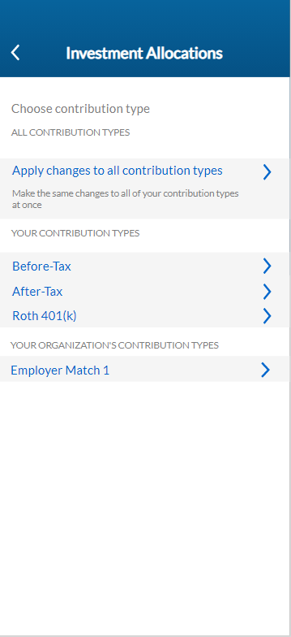
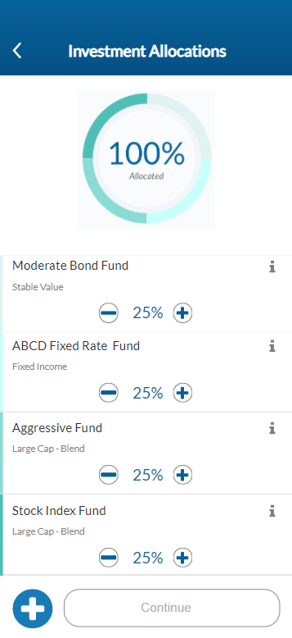

Slide 6
Driving participant satisfaction and business outcomes
iOS App Store rating improved from 1.4 to 4.7
Android Google Play Store rating improved from 1.9 to 4.6
App users increased 410% from 170,000 to 697,000
32.5K DAU, and 197K MAU.
92k+ users increased contributions via the app
181,000 monthly unique visitors in 2020
Personalized financial wellness tips, articles and videos
"The new UI is pretty slick and intuitive. I can quickly get an update on my account with the data loading pretty fast."
"Easy to use, setting up app is very quick and I can easily change my contributions."

Slide 7
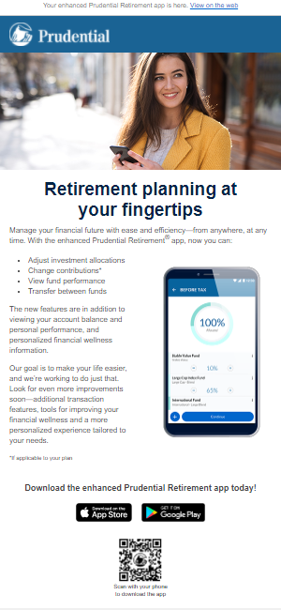
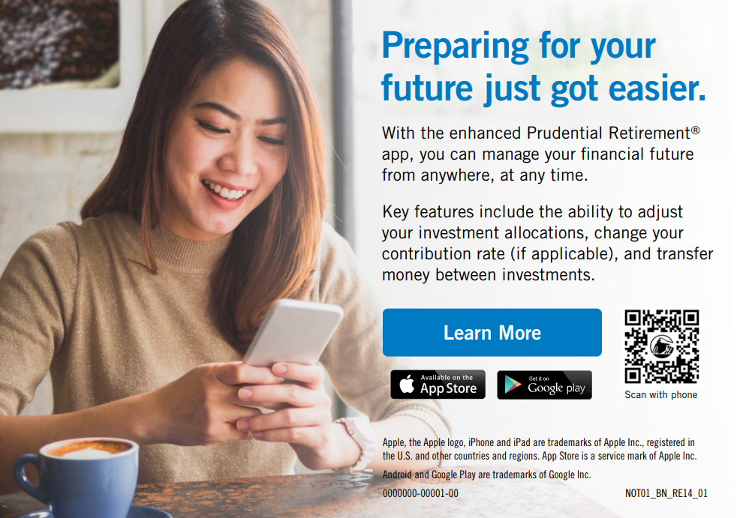
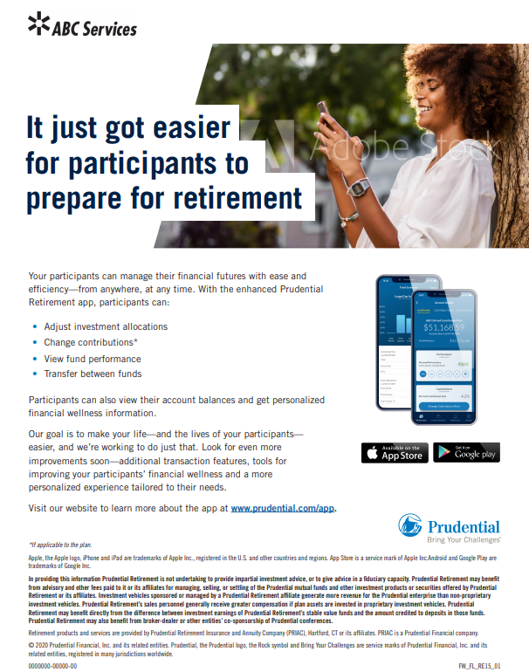
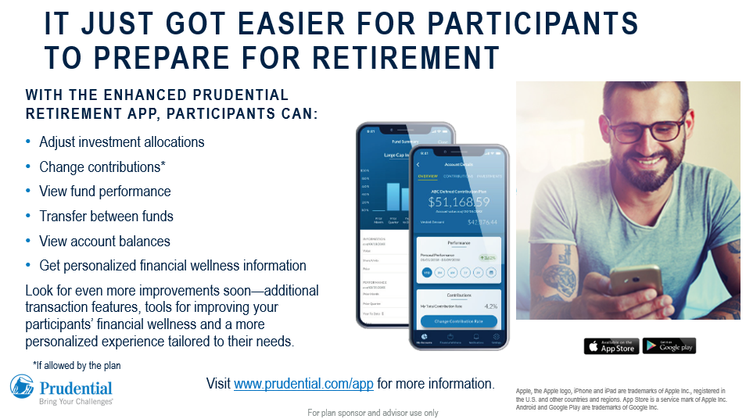
Marketing Support- Samples

